Slide 1
Loan Status Approval Prediction
Using Machine Learning
Guided by- Prof. Soniya Jain
By – Sarna Karandeep Singh
Enr No- 202126940109
Gujarat University (CPC Building)

Slide 2
Outline
Introduction
Literature review
Problem statement
Proposed work
Simulator
Results
Conclusion
Future work
References

Slide 3
Introduction
  This addresses the critical issue of loan eligibility prediction in the banking sector. As financial institutions face increasing pressure to make accurate lending decisions, utilizing machine learning models can enhance the efficiency and reliability of this process.
Motivation: Highlight the need for a system to automate loan approval and improve decision-making.
The critical issue of loan eligibility prediction in the banking sector is the focus of this study. Financial institutions face significant challenges, such as time-consuming manual processes and error-prone decision-making. The integration of machine learning can enhance efficiency, streamline approvals, and improve risk management. This presentation introduces an automated, accurate, and objective loan approval system leveraging machine learning techniques.

Slide 4
Introduction Cont.
Importance of machine learning in banking
Current challenges in manual verification
Automated loan prediction system for banking institutions
Aims to provide quick, straightforward approach for selecting qualified candidates
Uses machine learning for accurate loan approval decisions
Processes multiple customer parameters for comprehensive assessment

Slide 5
Literature Review
RP-1 : Loan Prediction System Using Machine Learning By - Anant Shinde et al.
ITM Web of Conferences
Summary--
The "Loan Prediction System Using Machine Learning" automates the loan
approval process for banks, reducing manual efforts and improving decision-making accuracy.
It uses logistic regression and random forest models to predict loan eligibility based on features such as income, credit history, and EMI.
The system analyzes and processes data to identify eligible loan applicants, achieving a prediction accuracy of up to 82%.
The automation helps banks save time and effort while minimizing the risk of defaults by accurately selecting trustworthy applicants.
This approach ensures a quick, efficient, and data-driven loan approval process, benefiting both bank employees and applicants.

Slide 6
Literature Review
The literature highlights advancements in automating loan approval using machine learning. Various studies demonstrate that models like Random Forest, Logistic Regression, and AdaBoost provide substantial improvements in decision-making accuracy. These works reveal how data preprocessing, feature selection, and ensemble methods enhance prediction precision while reducing defaults and human errors.

Slide 7
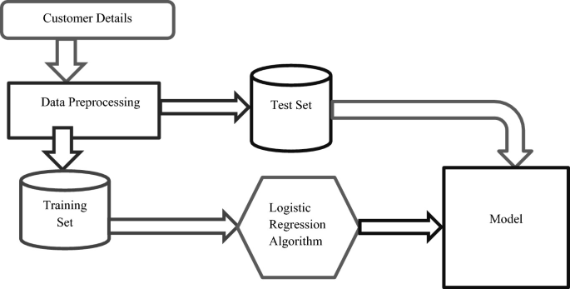

Slide 8
Outcomes / Accuracy
Logistic Regression: 72%
Random Forest: 79%

Slide 9
Literature Review
RP 2 - Shaikh.Bhanu1, Dr. Y. A. Siva prasad2
International Journal Of Novel Research And Development
Vol. 9, Issue 7 July 2024
The study focuses on developing a machine learning-based model for predicting loan eligibility, aimed at improving banks' decision-making efficiency.
Various algorithms, including Random Forest, SVM, Logistic Regression, and Decision Tree, were evaluated for accuracy.
Among these, the Random Forest algorithm demonstrated the best performance with a 94% accuracy, owing to its ensemble learning capabilities.
This model streamlines the loan approval process, reducing time and risk for banks while enhancing the accuracy of selecting eligible applicants.
Implemented in Python, the approach uses data mining techniques and classification methods to train and test the predictive model.

Slide 10
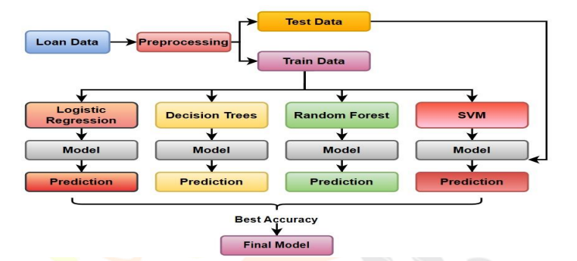
Literature Review Cont.

Slide 11
Algorithms
Various models including –
Logistic Regression,
Decision Tree,
Random Forest,
SVM

Slide 12
Outcomes / Accuracy
Precision: Varies by model;
Best Precision: 87.18% (XGBoost),
Best F1-score: 0.8957 (AdaBoost);
Overall best model: AdaBoost.

Slide 13
Outcome / Accuracy
Accuracy,
Precision,
Recall,
F-score (ANN: 0.8343, Tab Net: 0.8284, NODE: 0.7870 with chi-square selection)
Future Work - Assumes the data is clean and representative. Future work could explore additional features and ensemble methods.

Slide 14
Outcome / Accuracy
Random Forest: 88.89% accuracy;
SVM: 88.89% accuracy;
KNN: 84.44% accuracy;
Logistic Regression: 86% accuracy;
Gaussian NB: 80% accuracy;
Gradient Boosting: 77.78% accuracy

Slide 15
Literature Review
RP6 - R.Selvaganesh, Sk Magbul Basha, Sk Hasan Ali, S Ashraf Ali, S Sai Kiran
International Journal of Creative Research Thoughts (IJCRT)
IJCRT Volume 12, Issue 4 April 2024, ISSN: 2320-2882
Machine learning can be used to predict loan status in the banking sector. The article explores different machine learning algorithms and finds that XGBoost Classifier outperforms Decision Tree, Random Forest and Support Vector Machine for loan status prediction.
XGBoost Classifier achieved an accuracy of 73.98% in loan status prediction. This suggests that machine learning can be a valuable tool for banks to improve their loan approval process.
There are future applications of machine learning in loan status prediction. The article explores ways to improve the accuracy of loan status prediction, such as incorporating big data analytics and artificial intelligence.

Slide 16
Outcome /Accuracy
Outcomes:
- DecisionTreeClassifier: 77.23%
- RandomForestClassifier: 75.60%
- SVM: 68.29%
- XGBoost: 73.98%
Parameters:
- Gender
- Education
- Self-Employment
- Marital Status
- Credit History
- Loan Amount
- Income

Slide 17
Literature Review
RP7 - Mr. V. Sravan Kiran, B. Teja Reddy, D. Uday Kumar, K. Sai Avinash Varma, T. Sheshi Kiran .
IJRASET (ISSN: 2321-9653, IC Value: 45.98, SJ Impact Factor: 7.538)
Objective and Methodology: The study aims to automate the loan eligibility prediction process using the Random Forest algorithm. By analyzing historical bank client data, the model evaluates various factors such as income, credit score, and family status to accurately determine an applicant's likelihood of loan approval, enhancing the decision-making process for banks.
System Design and Implementation: The proposed system involves five key modules: (1) dataset collection for training and testing, (2) preprocessing to handle incomplete or outlier data, (3) data collection through a web interface, (4) data analysis for eligibility assessment, and (5) model implementation using machine learning techniques. The Random Forest Classifier exhibited a high accuracy of 97% in predicting loan approval.
Results and Future Enhancements: The implementation successfully streamlined the loan qualification process, providing quick and reliable predictions with reduced error rates. Future improvements include enhancing accuracy, reducing processing time, and integrating active learning techniques to assist bank workers in decision-making, ultimately optimizing the loan approval workflow.

Slide 18
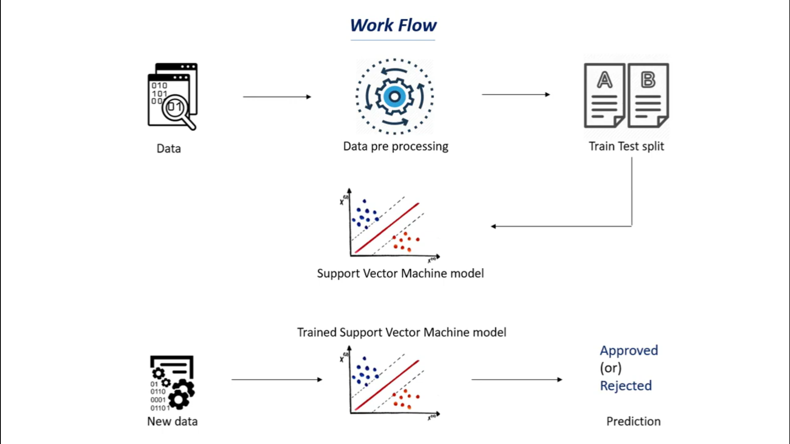

Slide 19
Outcome/ Accuracy
Outcomes:
- 97% training accuracy achieved
- Successfully automated loan eligibility prediction
- Reduced workload for bank employees
Parameters:
- Gender
- Family Status
- Occupation
- Number of Dependents
- Income
- Loan Term
- Credit Score

Slide 20
Problems Statements
Inefficiency in Manual Loan Approval Processes:
Traditional loan approval methods are often slow and prone to human error, leading to delays in decision-making and potential customer dissatisfaction. This inefficiency can hinder banks from serving their clients effectively in a competitive financial landscape.
Subjectivity and Bias in Decision-Making:
Manual evaluations of loan applications may introduce biases based on personal judgment or incomplete information, resulting in inconsistent decisions and unfair treatment of applicants. This raises concerns about the objectivity and fairness of the loan approval process.
Challenges in Data Management:
Banks often struggle with managing and analyzing large volumes of client data, which can be incomplete or contain outliers. This lack of effective data preprocessing can adversely affect the accuracy of eligibility predictions and lead to poor decision-making.

Slide 21
Problem Statement
Manual loan approval processes are inefficient, prone to bias, and limited by incomplete data analysis. Many financial institutions lack advanced predictive analytics for real-time, unbiased decision-making. Addressing these challenges requires robust automated systems to process client data and deliver objective and immediate results.

Slide 22
Proposed Worked
Our solution is an automated loan approval system utilizing the Random Forest algorithm. This system incorporates:
A standardized and objective decision-making framework.
Robust data preprocessing pipelines.
Real-time decision support systems for accurate loan eligibility predictions.
Continuous learning methods to adapt and evolve with new data.

Slide 23
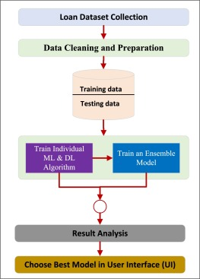
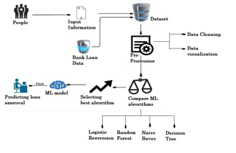

Slide 24
Simulator
A simulation environment is developed to evaluate machine learning models for loan prediction. Using Python with libraries like Scikit-learn, Pandas, and XGBoost, we trained and tested eight models. Kaggle's dataset serves as the basis, with preprocessing steps including handling missing values and feature encoding. The AdaBoost model emerged as the best performer, achieving an F1-score of 0.8957.

Slide 25
Simulator
Steps in Simulation
Data Preparation
  Dataset: Kaggle’s Loan Prediction Problem Dataset.
  Preprocessing: Handled missing values, encoded categorical variables, and removed redundant fields.
Modeling
  Trained eight models: SVM, KNN, Logistic Regression, Decision Tree, Random Forest, XGBoost, AdaBoost, and GBDT.
  Used 80% data for training and 20% for testing.
Evaluation
  Key Metrics: Accuracy, Precision, and F1-Score.
  Confusion matrix for detailed error analysis.
Outcome
  Best Model: AdaBoost (Accuracy: 84.95%, F1-Score: 0.8957).
  XGBoost achieved the highest precision (87.18%) but faced overfitting challenges.

Slide 26
Results
AdaBoost achieved the best overall performance with a balance of accuracy and generalization.
Accuracy: AdaBoost (84.95%), Logistic Regression (83.18%), Random Forest (84.07%).
Precision: XGBoost (87.18%) outperformed others but showed overfitting tendencies.
F1-Score: AdaBoost (0.8957), reflecting superior predictive ability for both defaulters and non-defaulters.
The simulation validated the effectiveness of ML models in automating loan eligibility predictions.

Slide 27
Conclusion
The study demonstrates that machine learning can revolutionize the loan approval process, providing financial institutions with reliable, efficient, and objective decision-making tools.
AdaBoost emerged as the most effective model, striking a balance between accuracy and fairness.
Automation significantly reduces manual errors, increases processing speed, and enhances customer satisfaction.
The integration of machine learning in the financial sector can support financial inclusion by enabling fair access to loans.

Slide 28
Future Work
Data Expansion: Incorporate larger, more diverse datasets to improve model robustness.
Advanced Techniques: Explore neural network architectures or hybrid models for even higher accuracy.
Real-Time Integration: Develop a dynamic system that continuously learns from new data.
Feature Engineering: Investigate additional predictive variables to enhance model performance.
User-Friendly Interfaces: Create intuitive dashboards for end-users to interact with predictions seamlessly.

Slide 29
References
Gupta, A., Pant, V., Kumar, S., & Bansal, P. K. (2020). Bank Loan Prediction
System using Machine Learning. IEEE.
Ozili, P. K. (2021). Forum for Social Economics.
Sheikh, M. A., Goel, A. K., & Kumar, T. (2020). An approach for prediction of loan
approval using machine learning algorithms. IEEE.
Singh, V., Yadav, A., & Awasthi, R. (2021). Prediction of modernized loan approval
system based on machine learning approach. IEEE.
Kaggle Dataset (2019). Loan Prediction Problem Dataset. Available at
https://www.kaggle.com/datasets/altruistdelhite04/loan-prediction-problem-dataset.

Slide 30
Thank You

